Slide 1
SOU Accessibility (PRM) Forum
Agenda:
Welcome and Apologies
Previous meeting
TORs
CAA Reports
Feedback from other mtgs – AOC, ACC, CAA
Performance – Stats/KPIs
Customer Feedback
Misc:
PRM Charges/Training/Initiatives/Equipment/Infrastructure/ Visits
Charity Updates
AOB
Date of Next Meeting (April 2023 date TBC)

Slide 2
Members (Attendance & Apologies)
Chair: Cllr Janice Asman Eastleigh Borough Council
Southampton Airport:
Terminal Operations Manager – James Alderson
Julie Stirling – Ops Director Assistant
Jose Vidal– OCS (PRM Service Provider)
Disability Advice Independent Support (DAIS) – Sonya Collins
Disability Advice Independence Support - DAIS Disability Advice Independant Support
Apologies – Steve Szalay Ops Director Southampton Airport

Slide 3
Terms of Reference
No formal guidance in CAA CAP 1228
CAP1228: Guidance on quality standards under Regulation EC 1107/2006 (caa.co.uk)
Twice yearly – linked to stats for summer/winter seasons
Attendees by invitation only
Chair Cllr Janice Asman with ACC consultation
Attendees to include charities/organisation reps

Slide 4
CAA Report
Last report was graded GOOD in Dec 2020
CAP1978: Airport Accessibility Report 2019/2020 (caa.co.uk)
No report in 2021 due to covid

Slide 5
Feedback from other Meetings
AOC: N/A
ACC: N/A
CAA Visit/Audit: CAA have not yet completed an audit but are working closely to support Southampton with our PRM services.
Any others: N/A

Slide 6
Performance Stats / KPIs
OCS:
Total PRM’s handled in the quarter (Apr – SEP) was 5060
Quarterly penetration rate (by departing pax) is 2.72%
Complaints 2 /Compliments 1
Pre-notification at 36 hours for SOU was 3542 for the quarter with non pre notified at 1518 and adhoc at 1195
Operational focus on ad-hoc and asap requests as the non-prenotification numbers have remained high from the start of the contract in Sept 2021 and also on staff training and performance

Slide 7
Customer Feedback
Praise: 27
Complaints: 11

Slide 8
Misc
PRM Charges
Current charge per pax is £1.14 per departing passenger.
Training – All in date and mandatory training completed. Looking over winter seasons to engage charities for further specialist training.
Equipment – All serviceable
Visits
CAA visited 23rd February 2022 to meet and greet with the SOU team.

Slide 9
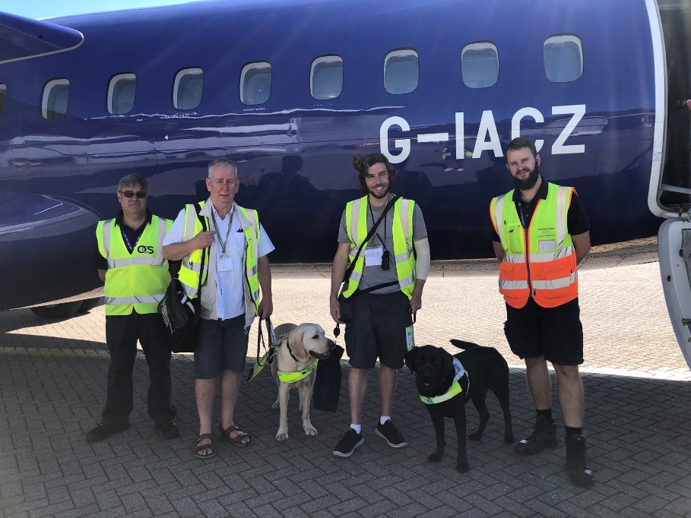
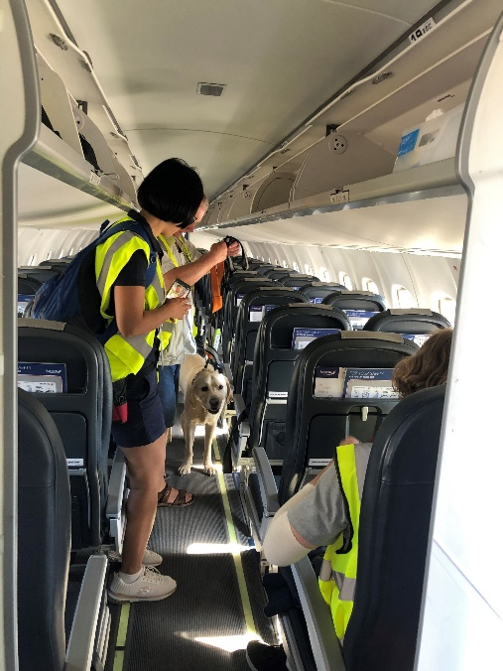
Charity Updates
10/08/22 - Guide Dogs for the Blind association. First guide dog training exercise is carried out by OCS and our Airside Operations team to ensure full familiarisation/training for the users and animals can be provided through the entire passenger process from arrival at the Terminal, security screening and on-board aircrafts. www.guidedogs.org.uk

Slide 10
AOB – Next Meeting
End of April 2023
To allow for stats for winter season 2022

Slide 11
29 April 2022 – Second mtg
Actions/Decisions:
Attendees:
CLL Janice Asman (EBC)
James Alderson (Terminal Manager)
OCS Sabina Amariei - OCS (PRM provider)
Julie Stirling (Ops Director Assistant)
OCS Sabina Amariei - OCS (PRM provider)
TORs to be drafted for next mtg – no formal guidance in CAP 1228
Last CAA report graded GOOD – 2020 (no report for 2021 due to covid)
OCS
Customer feedback:
Generally positive
Date of Next Meeting – end of April 2023 TBC
Frequency should be every six months, end of April and end of October – so can have stats for summer and winter seasons

